Slide 1
Queues and Stacks
Notes:
To create Em dash above headline:
Same size and weight as the headline and set using a soft return.
PC: Em dash (—): Alt+Ctrl+ - (minus)
Mac: Em dash (—): Shift+Alt/Option+hyphen

Slide 2
Agenda
Queues
Stacks
Sample Exercises

Slide 3
1. Overview
Notes:
To create Em dash above headline:
Same size and weight as the headline and set using a soft return.
PC: Em dash (—): Alt+Ctrl+ - (minus)
Mac: Em dash (—): Shift+Alt/Option+hyphen

Slide 4
Learning Objectives
Understand the structure and operations of:
Queues
Stacks
Be able to implement the above data structures

Slide 5
2. Queues
Notes:
To create Em dash above headline:
Same size and weight as the headline and set using a soft return.
PC: Em dash (—): Alt+Ctrl+ - (minus)
Mac: Em dash (—): Shift+Alt/Option+hyphen

Slide 6
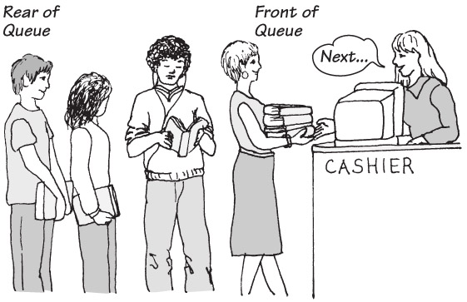
The Queue ADT
A queue is like a line of people
New items enter at the back (rear) of the queue
Items leave the queue from the front
Example
Teller at a bank or cashier in a supermarket
Queue operations
Test whether a queue is empty
Add new entry to back of queue
Remove entry at front of queue
Get entry added earliest to queue

Slide 7

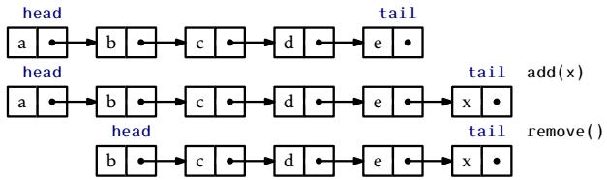
The Queue ADT
A queue is a sequence of items that follows the First-In-First-Out (FIFO) rule

Slide 8
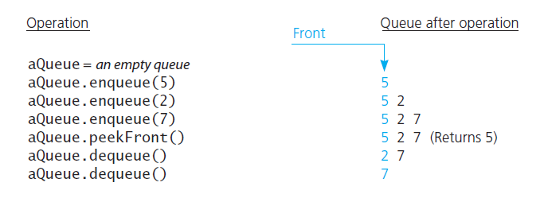
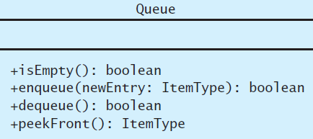
Queue Operations

Slide 9
Queue Examples
What do the initially empty queues - q1 and q2 – “look like” after the following sequence of operations
q1.enqueue(1)
q1.enqueue(2)
q2.enqueue(3)
q2.enqueue(4)
q1.dequeue()
qfront = q2.peekfront()
q1.enqueue(qfront)
q1.enqueue(5)
q2.dequeue()
q2.enqueue(6)

Slide 10
Queue – Enqueue
boolean enqueue(T data) { // T: generic data type Node u = new Node(); u.data = data;
if (n == 0) head = u;
else tail.next = u;
tail = u; n++; return true;
}

Slide 11
Queue – Dequeue
T dequeue() { if (n == 0) return null; // n is size of queue
T data = head.data; head = head.next;
if (--n == 0) tail = null;
return data; }

Slide 12
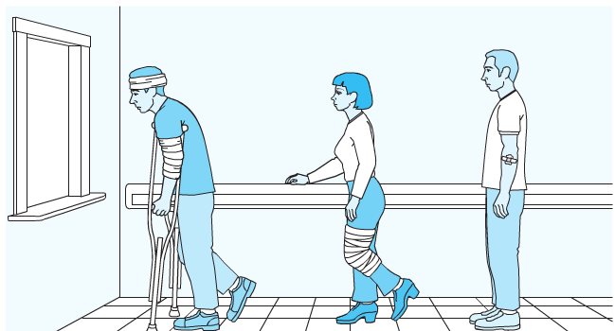
The Priority Queue
Operations
Test whether priority queue empty
Add new entry to priority queue in sorted position based on priority value
Remove from priority queue entry with highest priority
Get entry in priority queue with highest priority
Example
Hospital emergency room

Slide 13
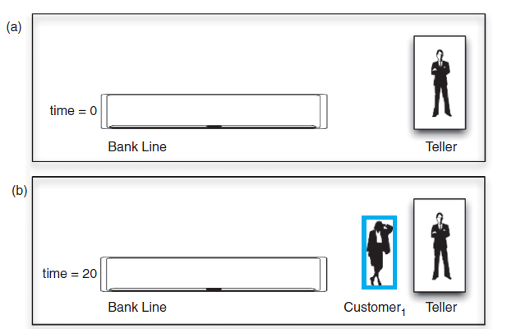
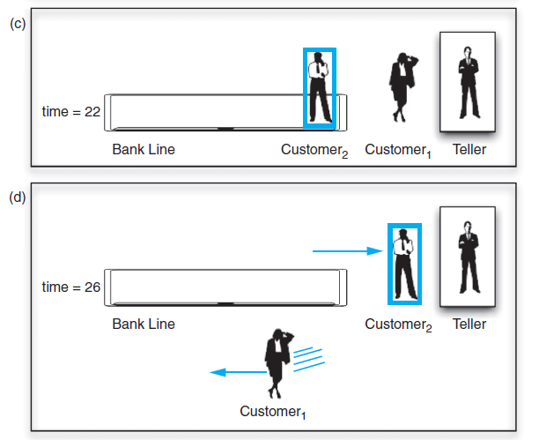
Model Bank Queue Wait Times
Determine how long customer waits to get service
Decrease customer wait time with each new teller
Objective to determine how many tellers to have
Arrival Time | Transaction Length
20 | 6
22 | 4
23 | 2
30 | 3

Slide 14
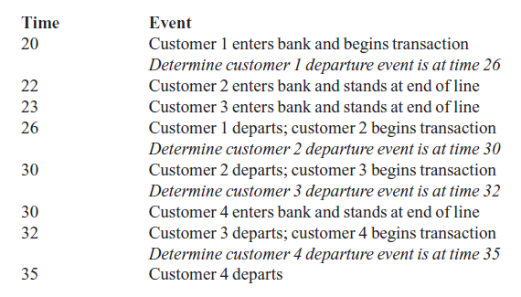
Application: Simulation Results

Slide 15
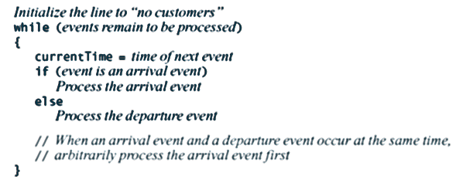
Application: Simulation
An event-driven simulation considers only times of certain events - In this case, arrivals and departures
Algorithm

Slide 16
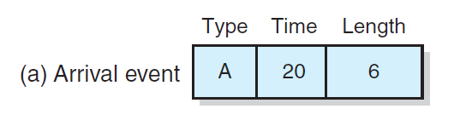
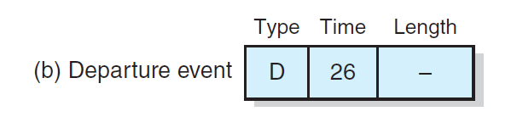
Application: Simulation

Slide 17
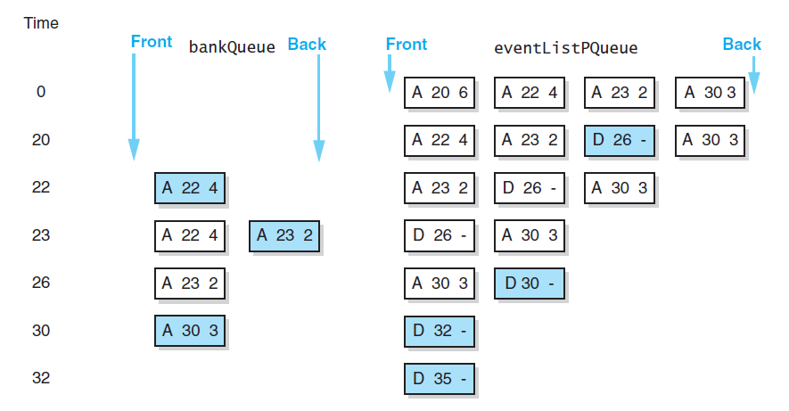
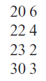
Application: Simulation
A trace of the bank simulation algorithm for the data

Slide 18
3. Stacks
Notes:
To create Em dash above headline:
Same size and weight as the headline and set using a soft return.
PC: Em dash (—): Alt+Ctrl+ - (minus)
Mac: Em dash (—): Shift+Alt/Option+hyphen

Slide 19
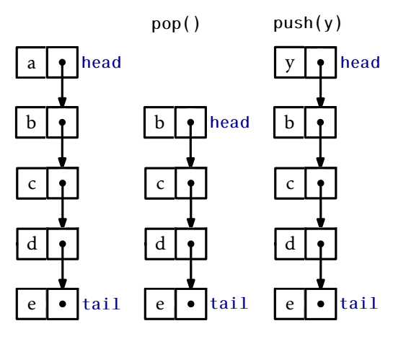
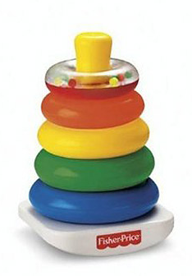
The Stack ADT
Stack is a sequence of items that follows the First-In-Last-Out (FILO) rule.

Slide 20
Stack – Applications
Discussion - What are the applications of the Stack data structure?

Slide 21
VTN-Air Flights
Adjacency List

Slide 22
Trace of Search Algorithm
Use of Stack to determine if we can fly between two cities

Slide 23
The Basics of Grammars
Special symbols
x | y means x or y
xy (and sometimes x • y ) means x followed by y
< word > means any instance of word, where word is a symbol that must be defined elsewhere in the grammar.
Python Identifiers = {string s : s is a legal Python identifier}

Slide 24
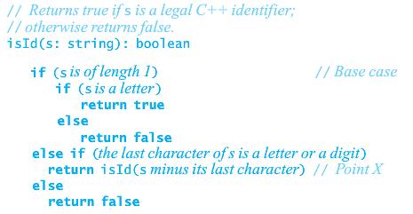
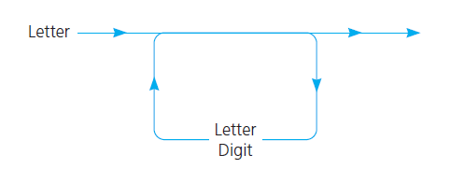
A syntax diagram for Python identifiers

Slide 25
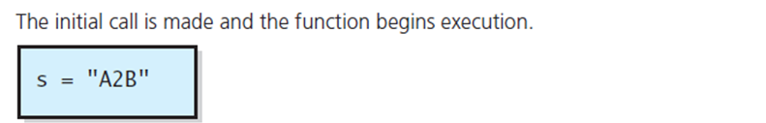
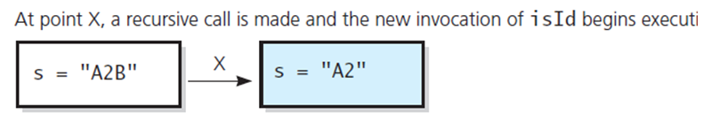
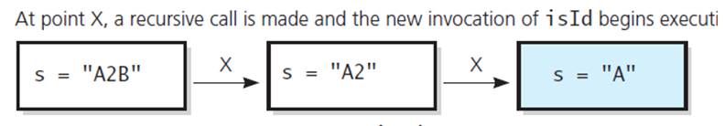
Algorithm to Detect Identifiers
Trace of isId("A2B")

Slide 26
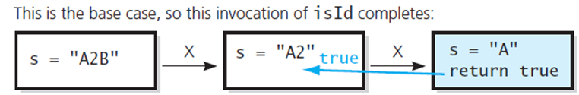
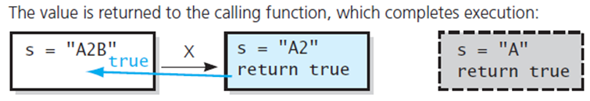
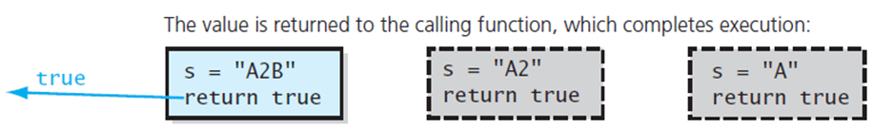
Parsing a Python Identifier
Trace of isId("A2B")

Slide 27
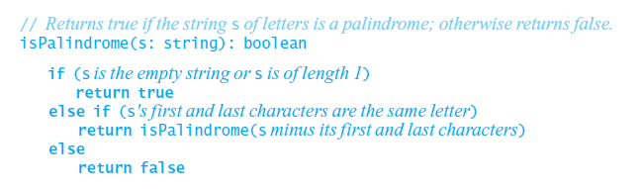
Example
Palindromes = {string s : s reads the same left to right as right to left}
Code that recognizes a palindrome:

Slide 28
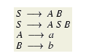
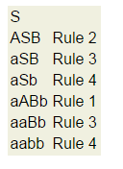
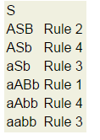
Grammars
By convention
S is the starting symbol
Uppercase characters are intermediate symbols
Lowercase are terminal symbols
Grammar
Two derivations of aabb

Slide 29
Examples
Define the grammar for a^{n}b^{n}
S --> aSb | λ - Note that λ or ε are used to represent null
A recursive solution that recognizes strings of the form a^{n}b^{n}
IsaAnBn(s: string): boolean
if (the length of s is zero)
Return true
Else if (s begins with A and ends with B)
Return (IsAnBn minus its first and last characters)
Else
Return false

Slide 30
Questions
Generate at least 4 strings in this grammar and provide the simplest expression that represents all the strings in this grammar.
S → aSc | X
X → bXc | ε
Provide a grammar that generates all even length palindromic strings made from 0 and 1. I.e. 0110 and 110011 are in the grammar, but 1010 (not palindromic) and 11011 (not even length) are not in the grammar.
How would you modify the language above to generate all palindromic strings made from 0 and 1?
Notes:
1)a**nb**mc**m+n
2) S - 0T1 and T – 0T1 or e
3) Same as 2 but also T can go to 0 or 1

Slide 31
More Questions
What language does this grammar generate?
S → $ | W | $ S
W → abb| aWbb
Approach - generate all options (brute force)
$, W, $S
$, abb, aWbb, $$, $W, $$S
Language examples
$, $abb, $$$aabbbb
This language contains all the strings of form:
$^{m}a^{n}b^{2n}

Slide 32
Arithmetic Expressions
What does this grammar generate
E → T
E → ( E + E )
T → N
N → 0|1|2|3|4|5|6|7|8|9
Example outputs
2
(2+3)
((2+3)+7)
To supports Python variables need to add
T → N|V, V →[a-z] W, W →[a-z, 0-9] W | ε

Slide 33
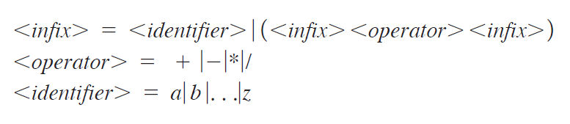
Fully Parenthesized Expressions
Grammar that defines language of fully parenthesized infix expression
What are the values of the following expressions?
5+2+3, 5 – 2 * 2, 5 – 4 – 3, 5 – 4 + 3, 3 * 2 ** 3, 2 ** 3 ** 2, 8÷2(4+4)

Slide 34
Algebraic Expressions
Infix - binary operator appears between its operands - a + b
Prefix - operator appears before its operands - + a b
Postfix - operator appears after its operands a b +
This is often called RPN or reverse polish notation
No need for ( ) in prefix/postfix
a+(b*c), + a * b c, a b c * +
(a + b) * c, * + a b c, a b + c *
Convert to prefix and postfix
(a + b) * (c – d)
2+3+4
(2+3) * 4
(2+3) * (5-4)
((2 + (6*3)) – (5+2))

Slide 35
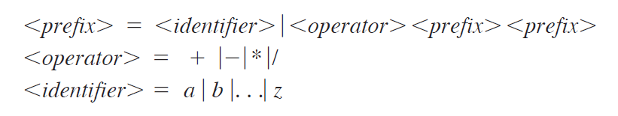
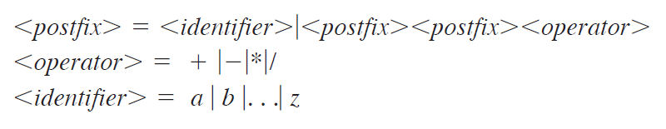
Prefix and Postfix Grammars
Grammar that defines language of all prefix expressions
Grammar that defines language of postfix expressions

Slide 36
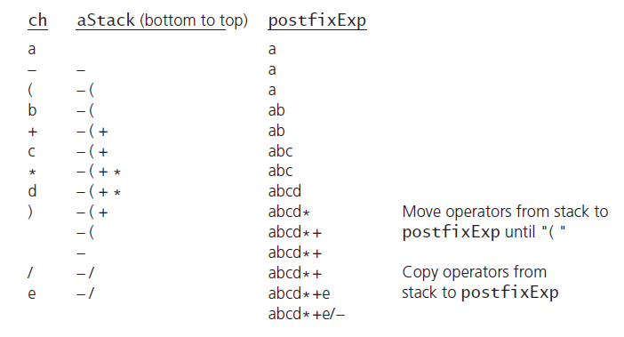
Converting Infix to Postfix

Slide 37
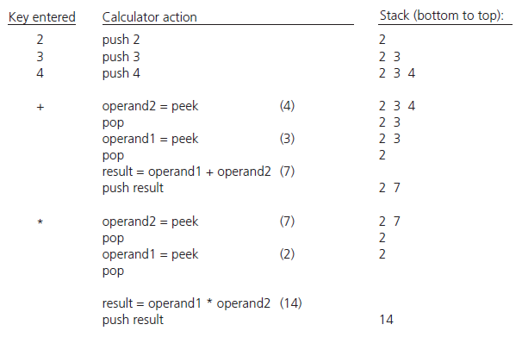
Evaluating Postfix Expressions

Slide 38
Stack – Push
T push(T data) { Node u = new Node();
u.data = data; u.next = head; head = u;
if (n == 0) tail = u; n++; // n is size of stack return data; }

Slide 39
Stack – Pop
T pop() { if (n == 0) return null; // n is size of stack
T data = head.data; head = head.next;
if (--n == 0) tail = null; return data; }

Slide 40
Stack – Array Implementation
class Stack {
static final int MAX = 1000;
int top;
int a[] = new int[MAX];
…

Slide 41
Stack – Array Implementation
boolean push(int x) {
if (top >= (MAX-1)) {
System.out.println("Stack Overflow");
return false;
} else {
a[++top] = x;
System.out.println(x + " pushed into stack");
return true;
}
}

Slide 42
Stack – Array Implementation
int pop() {
if (top < 0) {
System.out.println("Stack Underflow");
return 0;
} else {
int x = a[top--];
return x;
}
}

Slide 43
Stack – Built-in Class
java.util.Stack stack = new java.util.Stack();
empty();
peek();
pop();
push();
search();

Slide 44
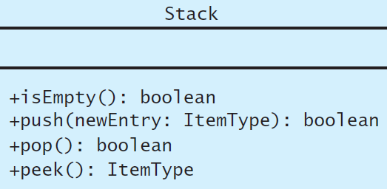
Comparison of Stack and Queue
Can be implemented using an Array or a List
Push inserts a new item at the top of the stack, enqueue inserts it at the back of queue
Pop removes the most recent item from the top of the stack, dequeue removes the first item from the front
peek gets the most recent item from the top, peekFront gets the first item from the front of the queue
isEmpty checks if any items exist in the ADT
Differences are whether function manipulates front or back of ADT

Slide 45
A List Generalizes Stack and Queue
List has getLength
insert replicates push and enqueue
remove replicates pop and dequeue
getEntry replicates peek and peekFront

Slide 46
Discussion and Exercises

Slide 47
Stack Exercises
How would you use a stack to detect if a string has balanced braces - delimiters (). {}, []
Valid - abc[d(ef)gh]i{jk}
Invalid - abc[d(ef)gh}i{j], abc(de}
How can you use a stack to recognize these languages
L = { s: s contains an equal number of A’s and B’s)
L = { s: s is of the form A^{n}B^{n} for some n >=0)

Slide 48
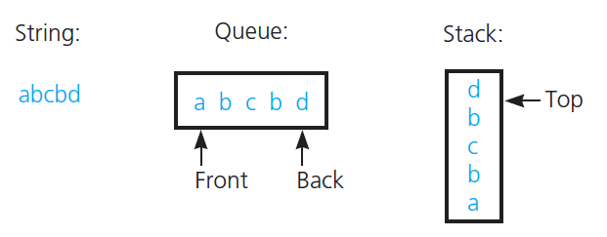
Using Queues and Stacks
How do we use a stack to reverse a string?
How do we use a stack to check if a string is palindromic?
How about using a queue and a stack?
The results of inserting the characters a, b, c, b, d into both a queue and a stack

Slide 49
More Stack Questions
Given two stacks, S1 that has data and S2 that is empty, how do you
Display the contents of S1 in reverse order i.e. display the top item last
Count the number of items in S1 leaving S1 unchanged
Delete every occurrent of a specific item in S1 leaving the remaining items unchanged

Slide 50
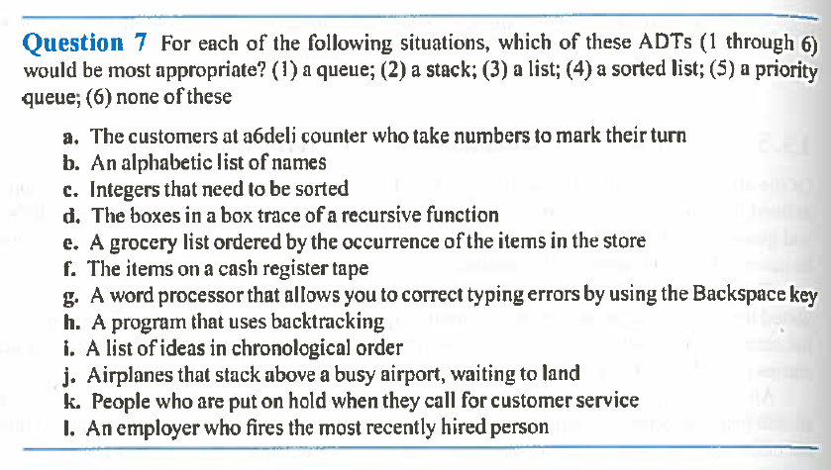
Questions

Slide 51
To finish…

Slide 52
Learning Objectives
Understand the structure and operations of:
Queues
Stacks
Be able to implement the above data structures

